Slide 1

Coursera Capstone Project

Slide 2
Introduction
In this capstone project for Applied Data Science, I would use techniques such as clustering to find an area where to open your own business is something that every new business owner struggles with. Toronto is a center of business, finance, arts and culture. Toronto is a city that is not only large but also with diverse communities. My mother is a pharmacist from India and we have been thinking for long time what could be the best location to open a pharmacy for her in the city where we have spent our time since we immigrated. This project would not only help my family make an important decision but also to all other people who want to open their own pharmacy in a beautiful city like Toronto.

Slide 3
Business problem
I want to find the best area for my family and many other to open a Pharmacy in Toronto which is the provincial capital of Ontario. This project is designed to provide solution to the problem by using data science methods and tools I have learned during the course along with the machine learning algorithm, K-means Clustering.

Slide 4
Target Audience
Entrepreneurs
Business owners looking for expansion in Toronto
New Business owners
Professional looking for relocation

Slide 5
Data
Let me provide you with a list of data that would be required to solve this problem.
List of Neighborhoods in Toronto
This dataset provides name of neighborhoods, name of towns and postal code. Using this dataset, we can get list of all neighborhoods grouped by different name of towns.
Latitude and Longitude
This can be found by using the following file: http://cocl.us/Geospatial_data .
It would result in dataframe with three columns: Postal Code, Latitude, Longitude.
Foursquare API
This is used to find venue data related to Pharmacy in Toronto. And it would also tells us which neighborhood needs to have a pharmacy opened. It would contain data of venues and venue categories for each neighborhood.

Slide 6
Data Extraction
Using the wikipedia link which contain postal codes of entire Canada, we can scrape data of neighborhoods located in Toronto.
To obtain latitude and longitude for each neighborhood, geocoder package from geopy library in Python was used.
To extract data for pharmacy in each neighborhood, Foursquare API was great help.

Slide 7
Methodology
To read the data from URL, lxml library is used. The column Borough is of no use so decided to drop it.
Checked if there is any row in neighborhood column is empty or not
We need to join neighborhood that has same postal codes to avoid ambiguity
Merge two data files one which contain postal code, latitude, longitude and another one is postal code, borough, neighborhood

Slide 8
Methodology(Cont.)
Save the merged data set into another file
Read the new file and group dataframe using Borough column by count of neighborhood
Search for borough containing Toronto which would give data of all different areas of Toronto
Using folium, map Toronto neighborhoods
Foursquare API can help us find pharmacy venue

Slide 9
Methodology(Cont.)
Calculate mean of all venues in Toronto and separate mean of venue pharmacy for each neighborhood
Label each neighborhood with a cluster using the calculated mean
We can map Toronto again using the clusters
Using the clusters we can see which cluster has lowest number of pharmacy

Slide 10
Results

Slide 11
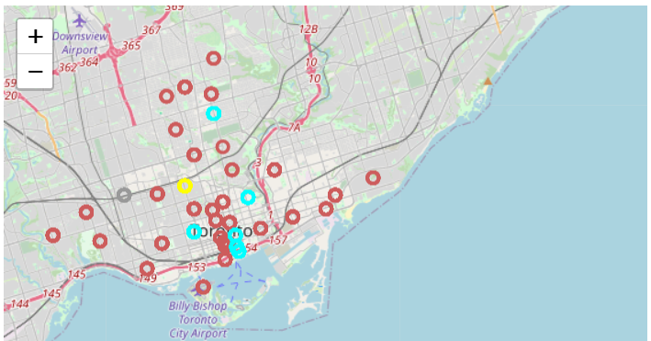

Slide 12
Discussion
Seeing the tables in the next few slides we can see that, it would be better to open a pharmacy in an area with cluster label 0, 1, and even 3 also. Cluster label 1 has only two pharmacies so it is safe to open a pharmacy in that particular neighborhood.

Slide 13
Cluster Label 0

Slide 14
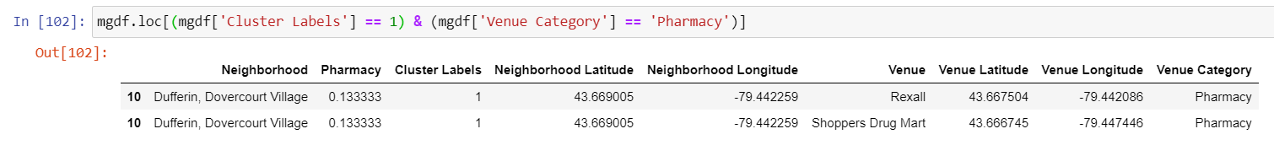
Cluster Label 1

Slide 15
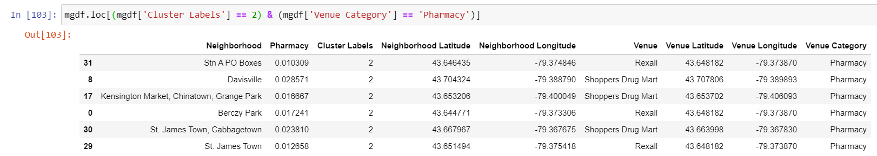
Cluster Label 2

Slide 16
Cluster Label 3

Slide 17
Conclusion
I have used K-means clustering algorithm to separate the neighborhoods in Toronto city into discrete clusters k=4 and also used 103 latitudes and longitudes. The coordinates had very much similar neighborhoods around. We have managed to figure out which neighborhood is suitable to open a pharmacy. By completing this capstone project, I have been able to see a realistic approach to address real life problem that has impact on personal as well as financial with the help of data science resources. The most interesting thing I learnt while working on the project is Folium. It is such an amazing technique integrating knowledge, enhancing interpretation of the given data and last but not the least, make decision related to the problem with confidence.

